Slide 1
Coalition Surge Test (CST) and Interoperable Communications Drill (IOC)
Pat Anders
Katharine Logan
Office of Health Emergency Preparedness
Notes:
Katharine

Slide 2
Real-Life Events
Notes:
Pat

Slide 3
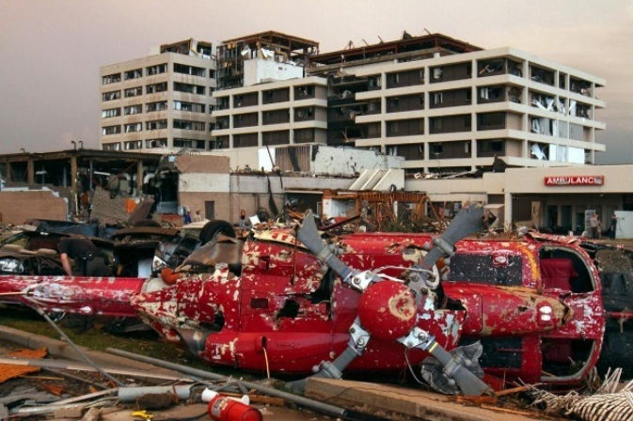
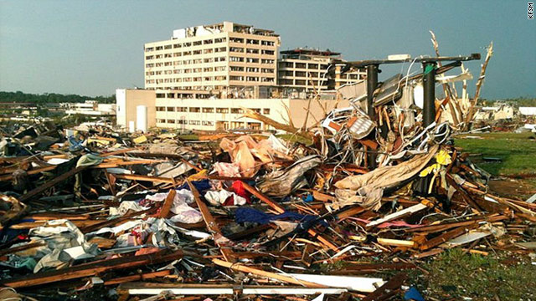
St John’s Regional Medical Center
May 2011
6 deaths in hospital
183 patients evacuated in 90 minutes
161 deaths in overall event
Notes:
Pat

Slide 4

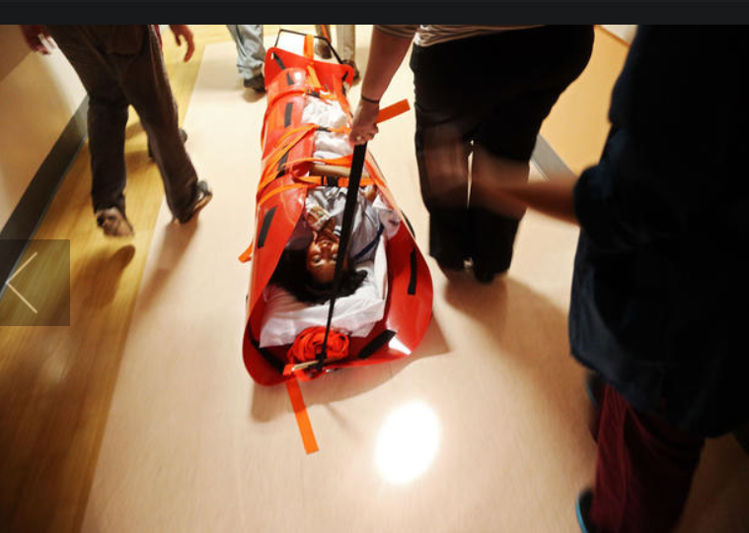
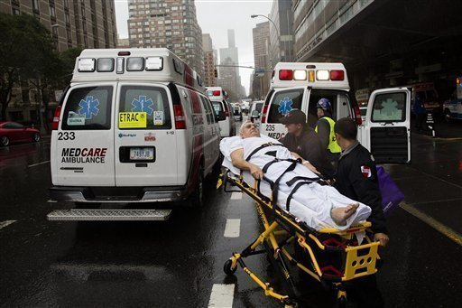
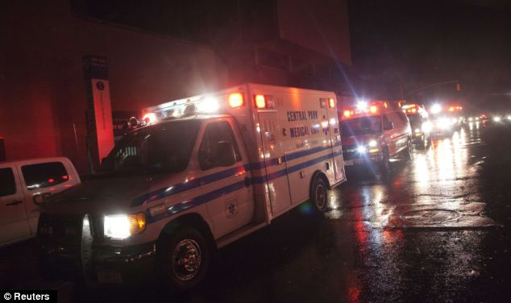
Superstorm Sandy
October, 2012
3 weeks after Sandy, 4 NYC hospitals remained closed
6,300 patients from 37 healthcare facilities evacuated
43 deaths, tens of thousands injured
Notes:
Pat

Slide 5



Boston Marathon
April, 2013
Boston Children’s Hospital
8 injuries, ranging from good to serious conditions
No children in critical condition
Ages range from 2 to 15 years old
Source: Reuters
Brigham and Women’s Hospital
31 injuries
9 in critical condition, one with “life-threatening” injuries
Source: ABC News
Massachusetts General Hospital
29 injuries
8 in critical condition
Several amputations
Source: The Daily Beast
Beth Israel Deaconess Medical Center
24 injuries, 7 released as of Tuesday morning
4 in critical condition, 13 in serious condition
Source: CBS News
Tufts Medical Center
9 injuries
Source: ABC News
Notes:
Pat

Slide 6



Pulse Nightclub Shootings
June 2016
50 died in the Pulse shootings, surpassing the previous high of 33 dead in 2007 when a gunman went on a rampage at Virginia Tech college.
2013 killings at Sandy Hook Elementary School in Newtown, Conn., left 28 people dead and one injured.
Mass shooting in San Bernardino, Calif. In December, 2015 left 14 dead and 21 wounded
In November, 2015, a coordinated series of attacks in Paris, including slayings at the packed Bataclan nightclub during a performance by Eagles of Death Metal, left 130 people dead.
44 injured to Orlando Regional Medical Center
12 – Florida Hospital Orlando
Notes:
Pat

Slide 7
Coalition Surge Test
Notes:
Pat

Slide 8
Goals of the CST
The CST is an annual requirement for coalitions beginning in BP1.
The CST is a low- to no-notice exercise.
  Ensures that HEPCs can transition quickly and efficiently into “disaster mode”
  Helps provide a more realistic picture of readiness than pre-announced exercises
  HEPCs will not know the exact date and time, and hospitals will not know whether they are an evacuating or receiving facility
The CST is designed to be challenging.
  More helpful in long run to struggle with a challenging exercise than an easier one
  Need to identify # of beds that can be made available, determine patient placement, match beds to those patients, and identify the transportation resources appropriate for the patients
Notes:
Pat

Slide 9
Goals of the CST
The CST is intended to enhance health care system response readiness.
  Tests:
    Functional surge capacity and identifies gaps in surge planning
    Ability to perform the tasks with existing on-site staff without excessive guidance or prompting
    If evacuating facility knows who to contact in evacuation scenario, and ability to reach partners on a moment’s notice
The CST tests the overall health care system response.
  Simulates an evacuation, but can demonstrate:
    Emergency Operations Coordination;
    Medical Surge Capacity;
    Information Sharing
Notes:
Pat

Slide 10
Benefits of the CST
Notes:
Katharine

Slide 11
Benefits of Exercising with the CST
Coalition Surge Test will encourage:
  Increased collaboration, cooperation, and communication
  Enhancement of preparedness at the facility level
  Increased engagement at coalition level, as well as at individual healthcare facility level
  Low / no-notice requirement benefits the Coalition in preparing for unexpected events
Notes:
Katharine

Slide 12

Coalition
It
Notes:
Katharine

Slide 13
So – How Will This Happen?
Notes:
Pat

Slide 14
How will this all happen?
Overview of CST
  Tests Coalition’s ability to:
    Find clinically appropriate beds for evacuating hospital patients with the assistance of other coalition members
    Uses a simulated evacuation (no actual patient movement) of up to 3 hospitals
      Evacuating facilities (representing 20% of a Health Care Coalition's acute-care bed capacity) enlist the help of other coalition members to find safe destinations for their patients and arrange transportation.
        i.e., if the Regional Coalition total acute-care bed capacity is 2,000 beds, then the simulated evacuation would be placement of 400 patients (20%)
Notes:
Pat

Slide 15
How will this all happen?
Overview of CST
  Tests Coalition’s ability to:
    Communicate & coordinate with medically appropriate transportation
    Identify the appropriate disposition for each patient (home with no services, home with home care, nursing home, another acute care hospital)
    Identify essential elements of information that helps inform situational awareness among HEPC members and partners
Notes:
Pat

Slide 16
How will this all happen?
Overview of CST
  Tests Coalition’s ability to:
    Respond to a LOW Notice exercise – within a two week window
    Focuses on the following patients for evacuation
      Long-term care (e.g., rehab hospital unit)
      Pediatric
      General med/surge - NICU
      ICU - Labor and Delivery
Notes:
Pat

Slide 17
Information Sharing for Situational Awareness
RO
Local Health Departments
Other Partners
NHs, ACFs, Home Care Agencies, CHCs
Notes:
Pat

Slide 18
Tools You Will Need
Notes:
Katharine

Slide 19







Interoperable Communications
Notes:
Katharine

Slide 20
People You will Need
Notes:
Katharine

Slide 21


Individual with Commerce account and role assignment to complete and submit the survey
Regional Office
Notes:
Katharine

Slide 22
Analysis and Documentation
Analysis of responses to the exercise must be conducted.
  Revise emergency plan, as appropriate
Must document compliance/ensure access to information at all times for at least 3 years.
If a facility is part of a health system with integrated/unified emergency preparedness program:
  Each separately certified facility must address individual needs of the facility AND
  Maintain individual record of exercises conducted to demonstrate compliance
Notes:
Pat

Slide 23
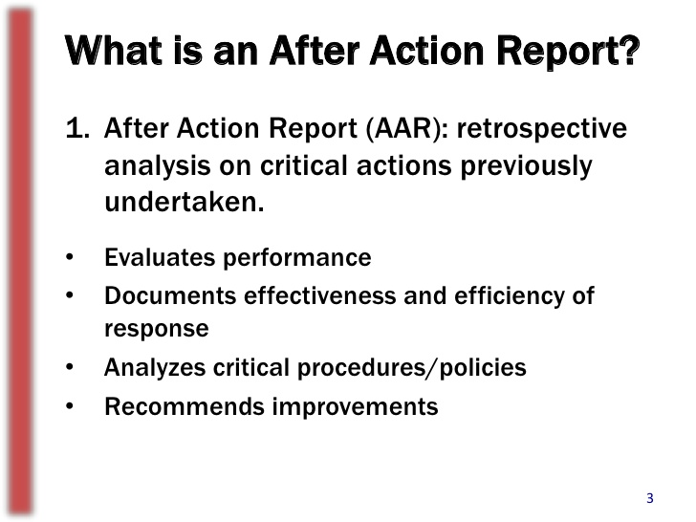
Finishing Up
Document lessons learned from the exercise. This must demonstrate incorporation of necessary improvements into EP training, policies, and programs.
Conduct an after-action review process (hotwash) to identify and document lessons
learned and corrective actions for
improvements in an official,
actionable After-Action Report.
Notes:
Pat

Slide 24
After-Action Reports
AARs should identify:
  What was supposed to happen
  What actually occurred
  What went well (STRENGTH)
  What the facility can improve upon (AREA FOR IMPROVEMENT)
  Timeline for incorporating necessary improvements (i.e., start time/end time)
Notes:
Pat

Slide 25

Questions patricia.anders@health.ny.gov katharine.logan@health.ny.gov

